Slide 1

Welcome to your Final Year Project
Dr. Mark Dixon (Module Leader)
Caedmon 118
With significant contribution
from Maurice Calvert

Slide 2
Overview
This module runs all year (self-driven)
This is the only double module (40 credits) on your course
Two submission points only – but with a lot of work to submit!
Most important module of your entire degree
Notes:
2

Slide 3
Project – Teaching
Lecture – first four weeks + guest lectures
Wed 1100-1200 in JG LTA
Tutorial – every week, 2 hours, with your supervisors (first five weeks)
Supervisory - meetings every two weeks (after week 5)
Notes:
3

Slide 4
Lectures Include:
Elements of your Project Plan including Ethics
Information Skills
Research Skills
Planning/Time Management
Development Methods
Critical Thinking
Report Writing
Employability
Notes:
4

Slide 5
Key Elements
Planning
You will be required to apply project management techniques throughout
Research
Academic type research
Technical research (support product build)
Product
A tangible artefact appropriate for your course
Final Report
Notes:
5

Slide 6
A Product?
Your project will have a product which you will submit during April (prototype needed in February).
A product can be anything you choose which is relevant to your course.
This might be a design for a network, a database system, a website, a methodology, a review of a system, a piece of software, a dissertation, a marketing report, a service you provide.
Notes:
6

Slide 7
A Product?
The product should be a non-trivial significant piece of work.
The overall project should be the correct standard –
we don’t want a Ph.D. thesis
equally we don’t want a Level 4 or Level 5 assignment!
Each project will be different, just set in a common framework (unlike assignments)
Notes:
7

Slide 8
A Product?
We have created a set of “Expectations” – one for each course (or pair of core modules for Computing students)
Read the appropriate expectations with care (available on MyBeckett).
You need to discuss this in detail with your supervisors (and others) in the next few days
Read the whole of the Module and Assessment guide (important)
Notes:
8

Slide 9
Ideas
Use the Computing Project Ideas Website
http://studentproj.aet.leedsbeckett.ac.uk
Username: computer Password: project
This is simply a repository of ideas from Computing staff and some external clients.
You will have to specify a project based on these or other ideas you may have.
Notes:
9

Slide 10
Individual or Team?
Team products can be bigger, better, more realistic.
You can build a multi-disciplinary team with each person working in their specialism.
This is difficult to achieve – what do you do about skill gaps?
Team projects are the reality throughout business – good selling point on your CV.
Notes:
10

Slide 11
Individual or Team?
Individual projects are easier to manage.
Individual projects have issues which affect only the individual.
Individual projects will be the default because we know that is what students prefer.
But – individual projects require good self management and motivation.
Notes:
11

Slide 12
Individual or Team?
If you need to find team members to work with you, e-mail me (m.dixon@leedsbeckett.ac.uk)
If you would like to join someone to form a team, look on the Computing Project Ideas Website or e-mail me (or both).
I will attempt to match any students who want to work on similar projects.
Notes:
12

Slide 13
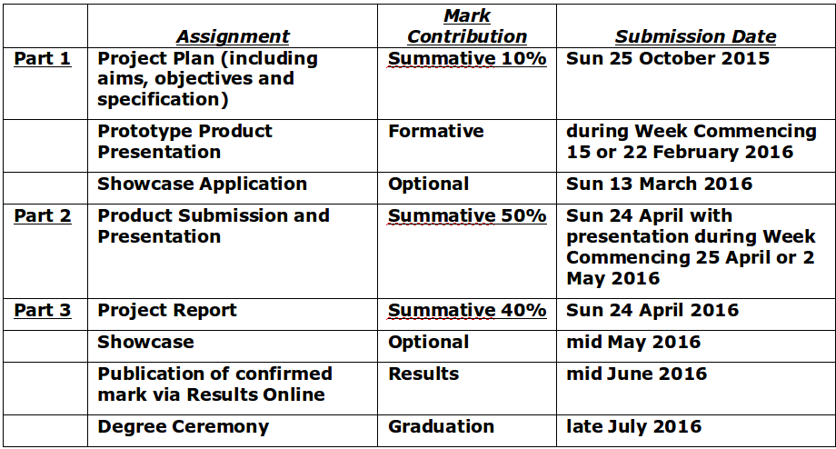
Level 6 Projects – Assessment

Slide 14
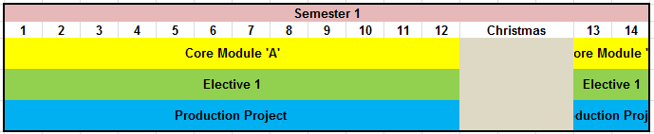
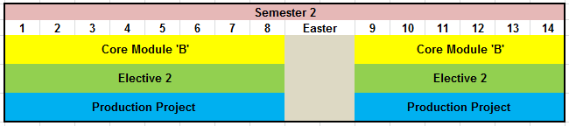
Computing area Awards – Structure of Year
Project Plan
Product and Final Report

Slide 15
You and Your Modules
Attendance/Expectations
Contact time 3 hours per week for five weeks – later individual tuition of 20 minutes per two weeks.
NEVER plan to miss a class
Support from supervisors is vital
LOTS of self-directed study – plan your time!
If you haven’t, start planning NOW!

Slide 16
Project Plan
This must be submitted by the end of Week 4
Your supervisors will advise on the production of this during tutorials
Your supervisor will be your personal tutor.
In the meantime, if you have any personal tutor issues, talk to any of your Production Project tutors.
A template for your Project Plan is on MyBeckett (Templates link).

Slide 17
Tips
The project is driven mainly by YOU!
You must work throughout the year and NOT just near the assessment points
Self-management and self-motivation are just as important as your academic or technical abilities
Your supervisor is your main point of contact during the project
The research needs to be in-depth, the product non-trivial, and the final report is 9,500 words. So you need to work hard!

